Slide 1


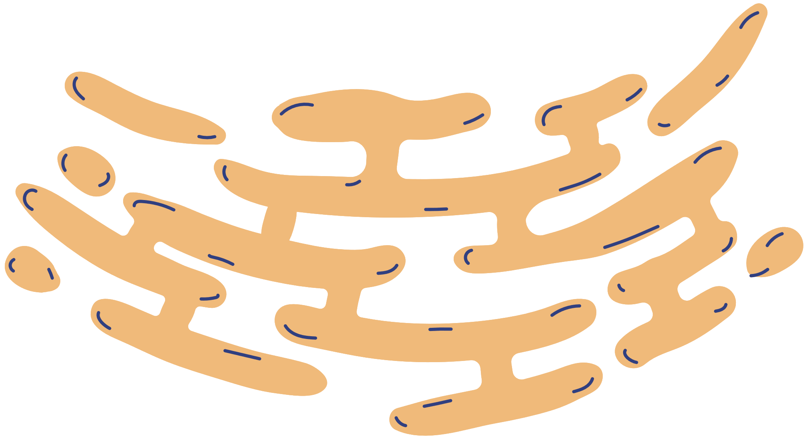
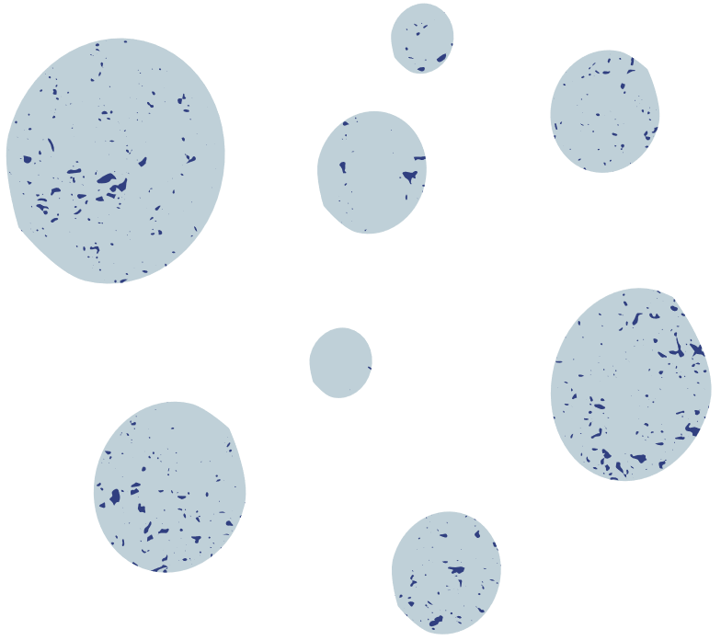

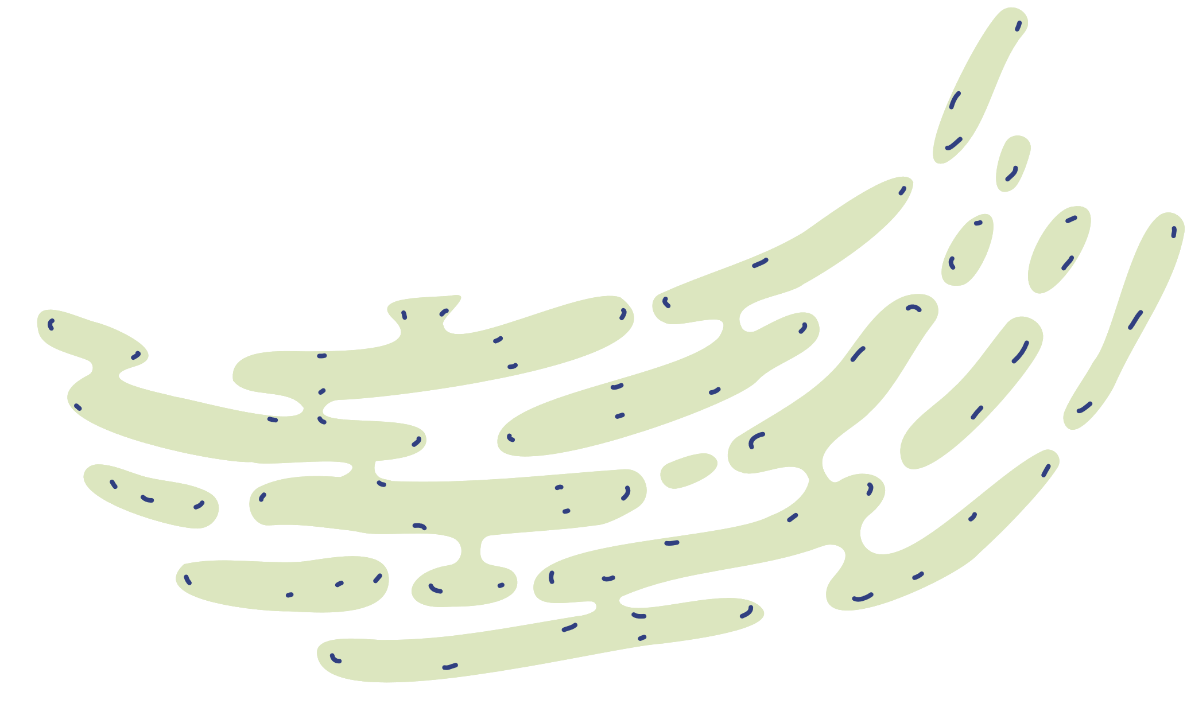
Predicting Anemia with Health and Lifestyle Factors:
A Comprehensive Analysis and Preventive Strategy using R
KOUSHIK VISHNU D - 21MIA1054
JANANI M - 21MIA1070
VARSHINI B - 21MIA1058

Slide 2

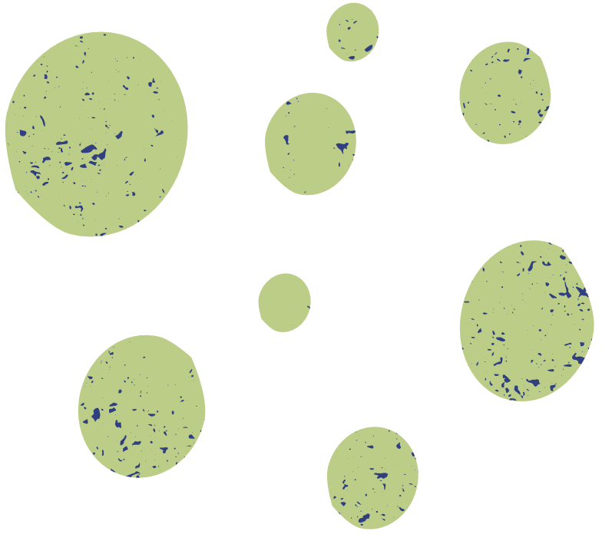
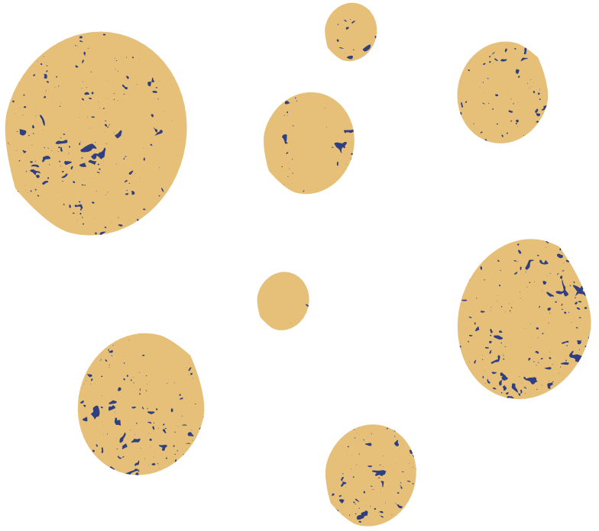
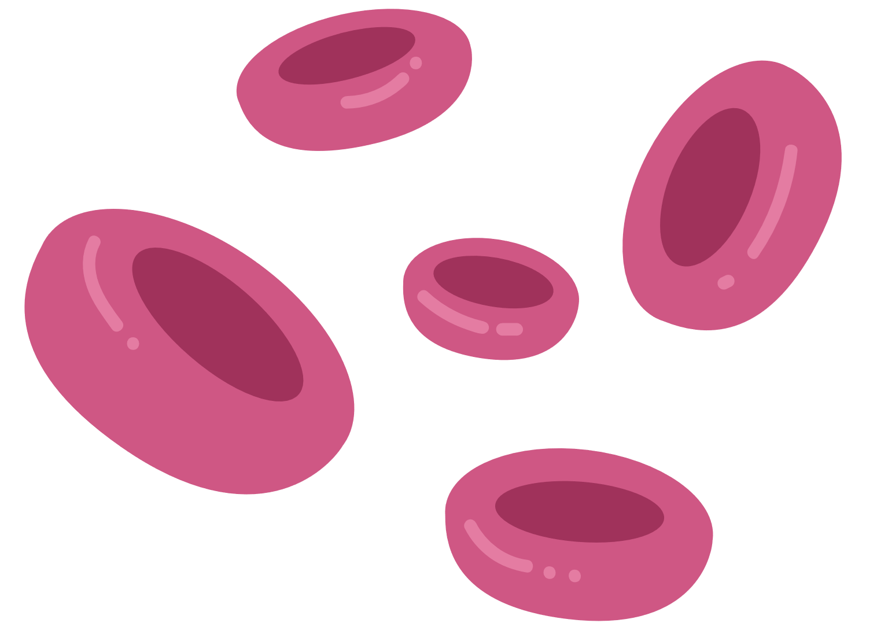

Abstract
Anemia, marked by a deficiency of red blood cells or hemoglobin, remains a significant health challenge, particularly among women aged 15-49.
This project utilizes predictive analytics in R to explore health and lifestyle factors contributing to anemia.
The goal is to offer actionable preventive strategies by analyzing variables such as smoking, alcohol consumption, age, gender, and health metrics.

Slide 3


Objective
To predict anemia using machine learning and identify key influencing factors.
Identify the most impactful health and lifestyle factors.
Offer personalized recommendations for anemia prevention.

Slide 4


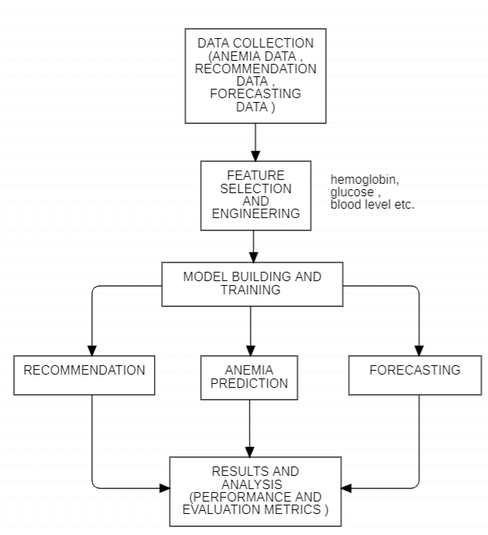

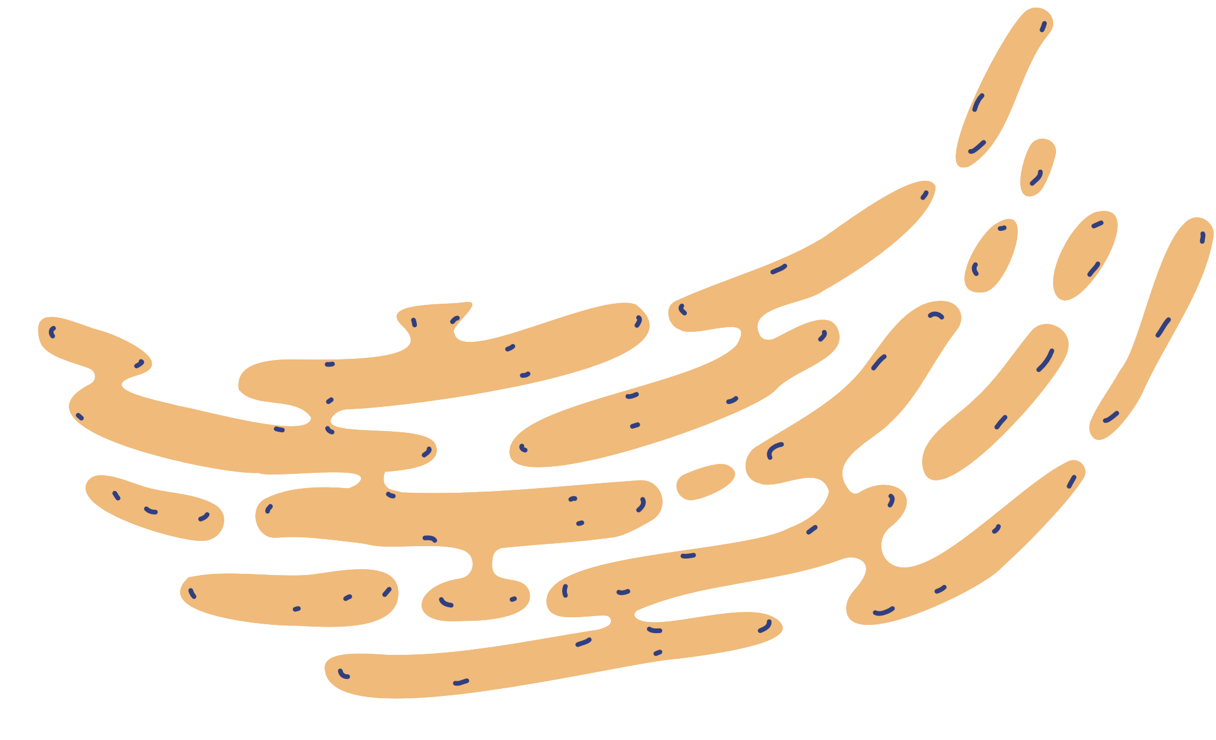

Architecture

Slide 5




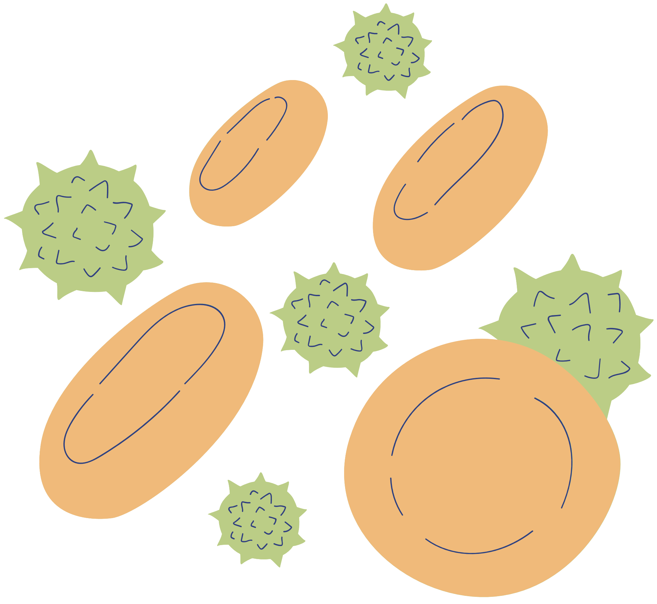

Patient Info: Age, gender, locality, health history (smoking, alcohol, diabetes), and health metrics (hemoglobin, TLC, platelets).
Dataset Overview
Data collected from Hero DMC Heart Institute (2017-2019).
Key Variables: 28 features including heart failure, STEMI, and anemia.

Slide 6
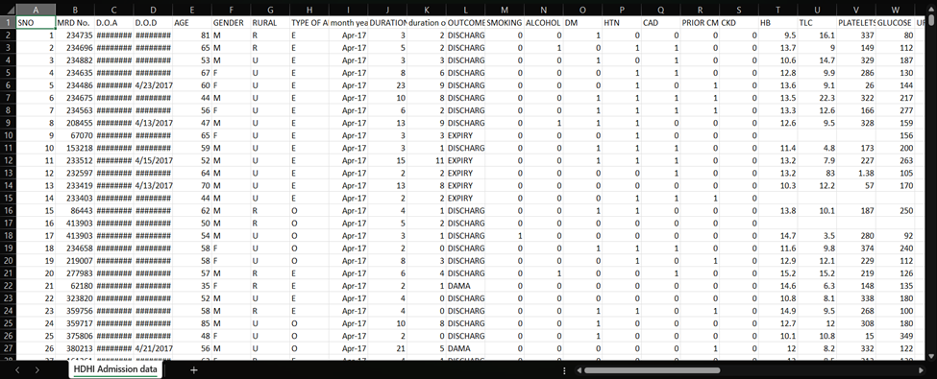
Dataset

Slide 7
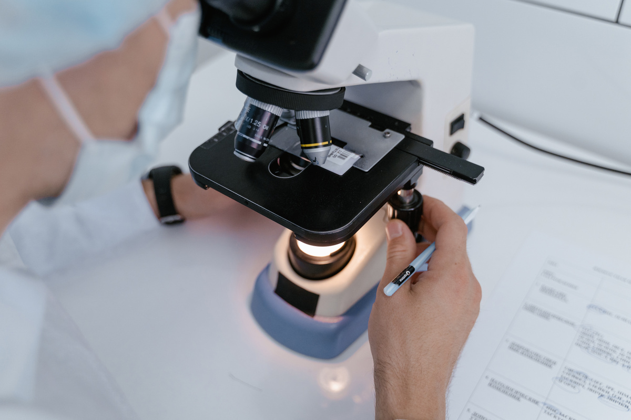
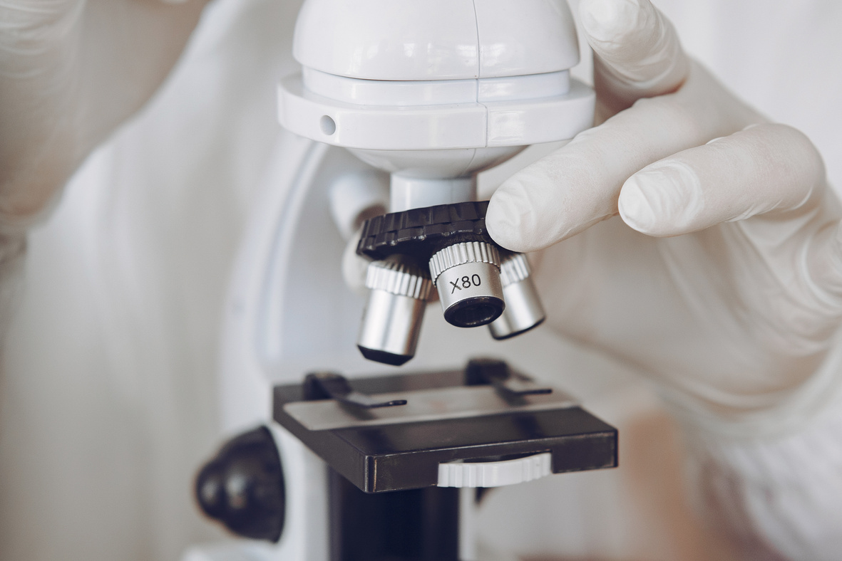
Modules
Step 1: Data Collection and Preprocessing
Load the dataset and clean missing values.
Convert categorical variables to numerical formats.
Split the dataset into training and test sets for validation.
Tools Used: dplyr, Hmisc, caret.
Step 2: Exploratory Data Analysis
Generate descriptive statistics for each variable.
Analyze correlations between anemia and other factors (age, gender, lifestyle).
Identify trends across demographic groups.
Tools Used: ggplot2, corrplot, dplyr.

Slide 8
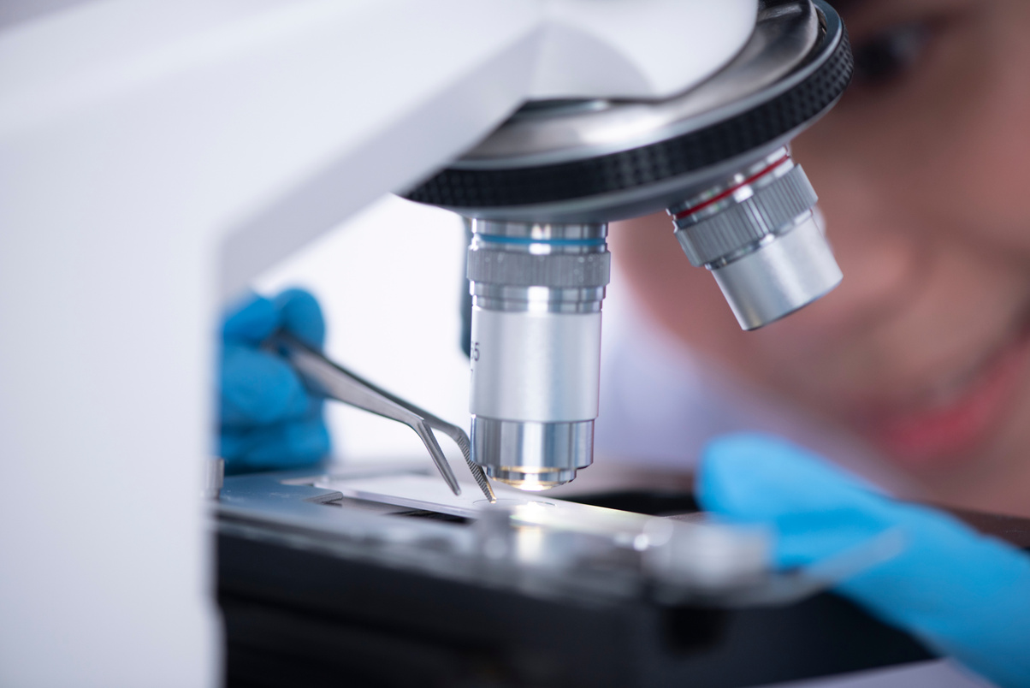

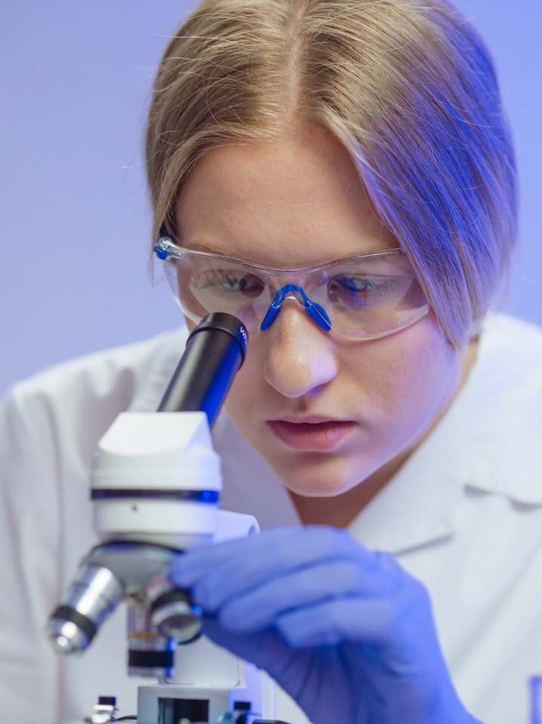
Modules
Step 3: Feature Selection and Engineering
Use statistical techniques to evaluate the most influential features affecting anemia.
Select features using feature importance metrics.
Tools Used: randomForest, caret.
Step 4: Model Development and Training
Train models including Random Forest, Decision Trees, and Logistic Regression.
Evaluate models using metrics like accuracy, precision, recall, and F1-score.
Tools Used: randomForest, caret.

Slide 9
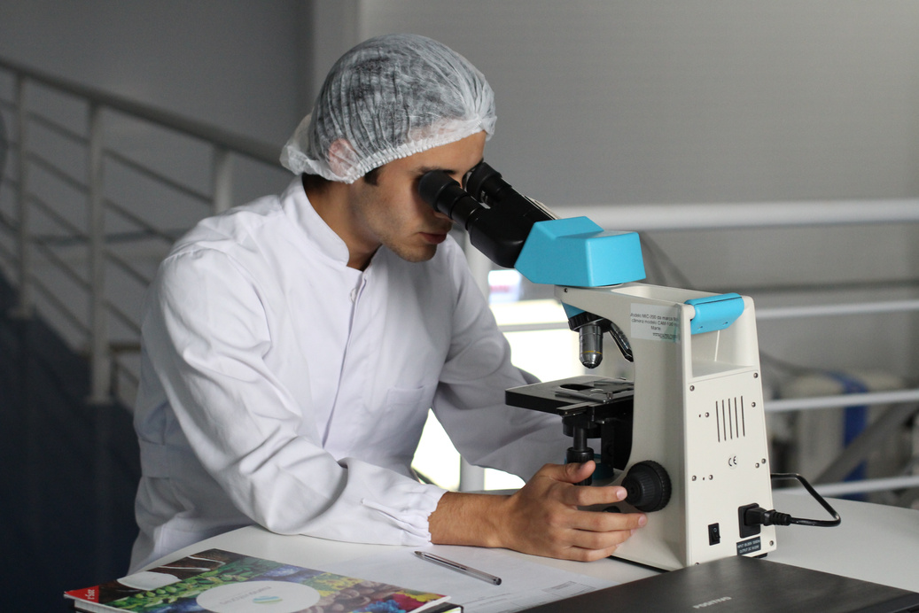

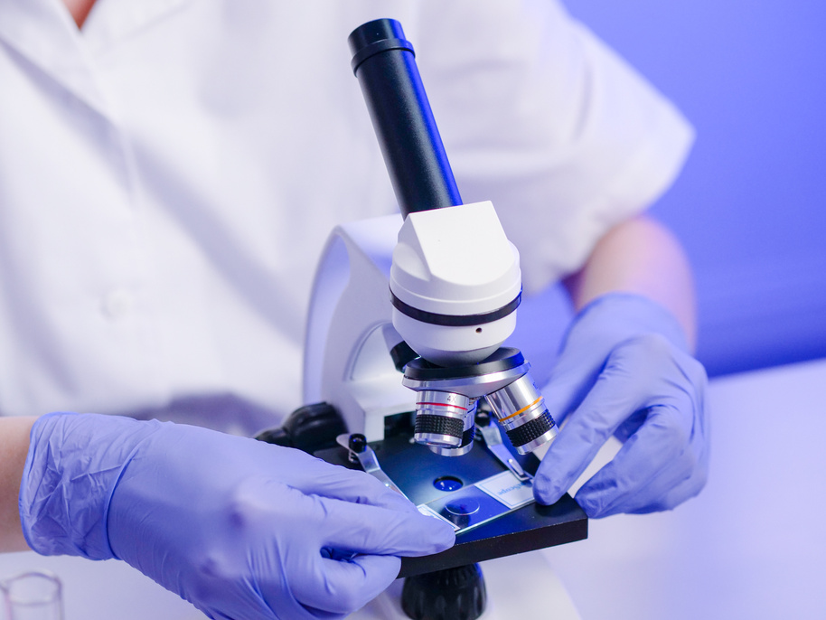
Modules
Step 5: Model Evaluation and Reporting
Generate a confusion matrix to measure performance.
Report on model metrics: accuracy, precision, recall, F1-score.
Visualize feature importance (e.g., hemoglobin, urea, creatinine).
Important Features: Hemoglobin, Urea, Creatinine, TLC.
Step 6: Forecasting and Insights
Strong correlation with urea and creatinine.
Hemoglobin has a strong negative correlation with anemia.
Highest risk of anemia in the 60+ age group.

Slide 10
Inference
Initial dataset: 15,757 rows. After removing null and empty values: 5,897 rows.
Gender distribution: Female: 699 cases, Male: 650 cases.
Age distribution: Highest observed presence in the 60+ group with 991 cases. Other age groups show lower counts, with the 50-60 group having 227 cases.
Correlation with Anaemia: Strong positive correlation with UREA (0.27) and Creatinine (0.26). Negative correlation with Haemoglobin (HB: -0.73), indicating low haemoglobin is a key factor for anaemia.
·Model Performance: Confusion Matrix shows perfect prediction with an accuracy of 100%. Sensitivity and Specificity both equal to 1, ensuring no false positives or negatives.
Important Features: Haemoglobin (HB) has the highest feature importance with a MeanDecreaseGini of 1,356. Other significant contributors: UREA (60.01), Creatinine (59.52), and TLC (27.09).

Slide 11
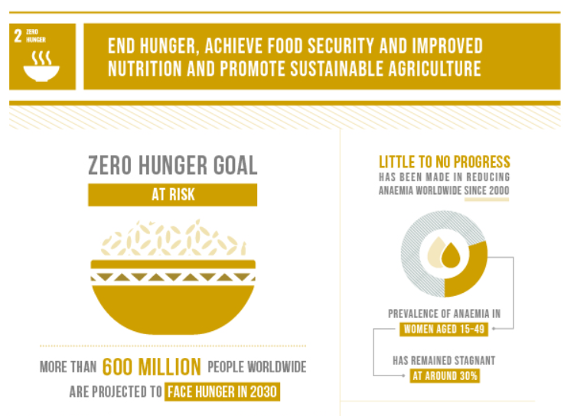
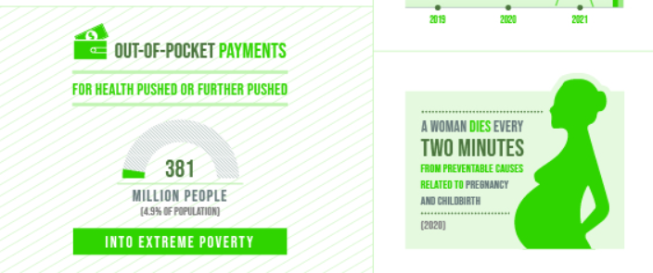
1). SDG 3: Good Health and Well-being
2). SDG 2: Zero Hunger

Slide 12
Review - 3
Predicting Anemia with Health and Lifestyle Factors:
A Comprehensive Analysis and Preventive Strategy using R
Health and lifestyle Features : 21
Goal:
reduce features
predict anemia
recommend wellness strategies

Slide 13
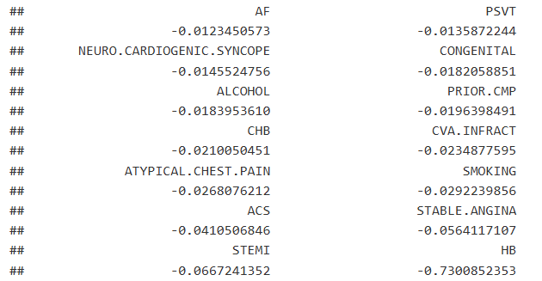
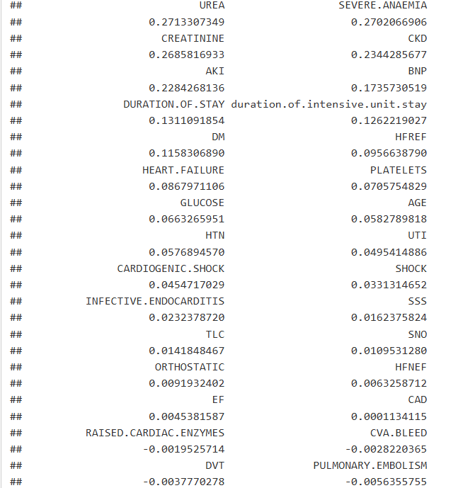
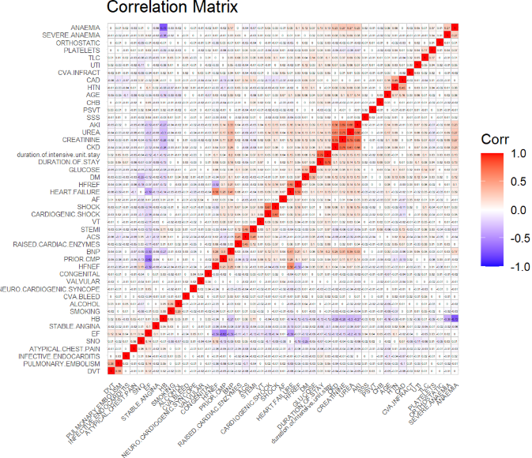

Slide 14
Identified features with essential
AGE
GENDER
HB
TLC
PLATELETS
GLUCOSE
UREA
CREATININE

Slide 15
Hemoglobin having strong negative correlation with -0.73 and models including random forest and decision tree predicts anaemia with 100 % accuracy !
What if, if we want to predict anaemia when we dont have the measure of hemoglobin and with other health factors

Slide 16
Evaluation Metrics
Models used: Random forest, logistic regression, decision tree
Model | Accuracy | Precision | Recall | F1score
Random Forest with hb | 99 | 99 | 100 | 99
Random Forest | 82 | 83 | 95 | 89
Logistic Regression | 78 | 79 | 97.2 | 87.22
Decision Tree | 77.67 | 79.36 | 96 | 86.9

Slide 17
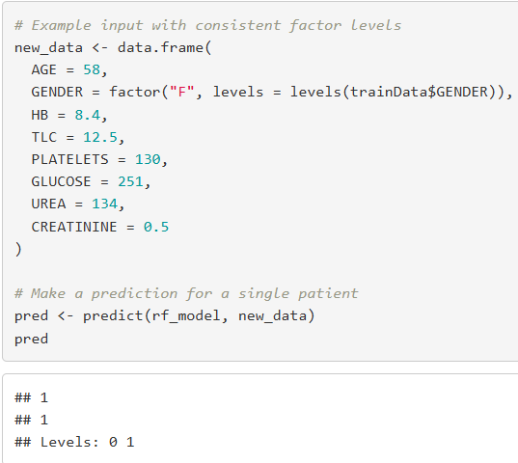
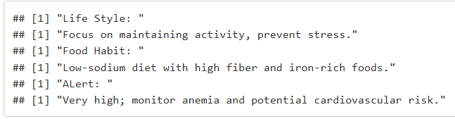
Recommendations

Slide 18
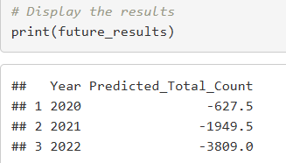
Forecasting: With the same dataset
Model | R2 | MAE | RMSE | MSE
Linear Reg | 0.0191 | 119.444 | 127.0201 | 16134.1
Ploy Reg | 0.99 | 8.166 | 9.1515 | 83.75
input: year
output: no. of people having anaemia
year available in data
2017 to 2019
While the error metrics (R², MAE, RMSE) show excellent fit on the training data, the model extrapolates poorly beyond the training period, producing negative predictions for future years. This suggests overfitting,

Slide 19
Forecasting: with different dataset:
Anaemia in Pregnant Women:
Model | R2 | MAE | RMSE | MSE
Arima | 0.983 | 0.32 | 0.35 | 0.12
Linear Reg | -14.652 | 1.21 | 1.29 | 1.65
Poly Reg | 0.907 | 0.08 | 0.1 | 0.01
input: year and country
output: % of people having anaemia
year available in data
2000 to 2019
no. of countries - 237

Slide 20
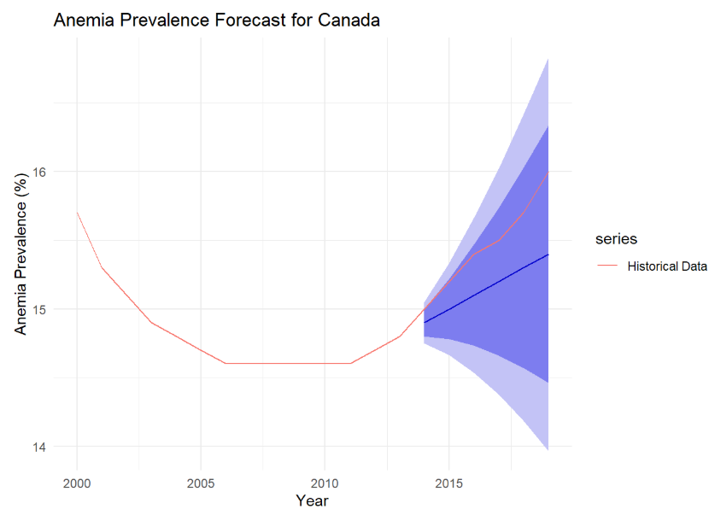
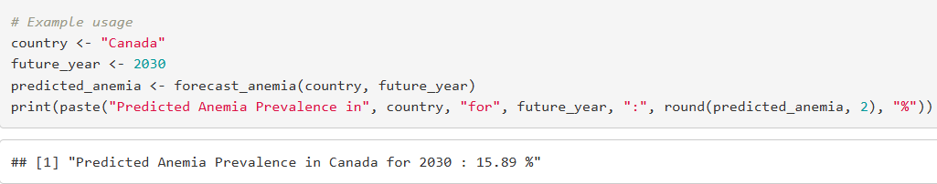
Forecasting: with different dataset:
Anaemia in Pregnant Women:

Slide 21
Forecasting: with different dataset:
Anaemia in non-pregnant Women (15-49):
input: year and country
output: % of people having anaemia
year available in data
2000 to 2019
no. of countries - 237
Model | R2 | MAE | RMSE | MSE
Arima | 0.99 | 0.85 | 0.98 | 0.96
Linear Reg | -2.204 | 2.51 | 2.7 | 7.29
Poly Reg | 0.854 | 0.53 | 0.58 | 0.33

Slide 22
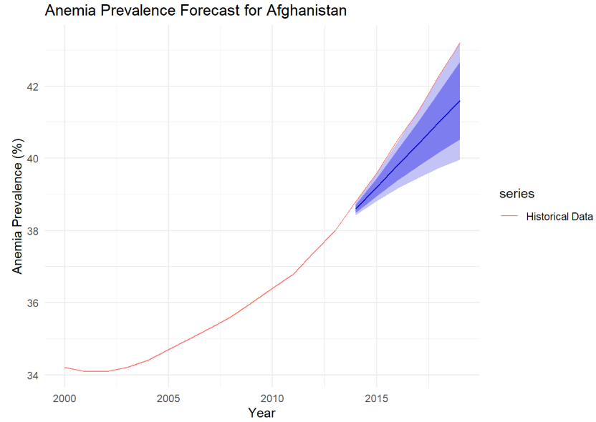
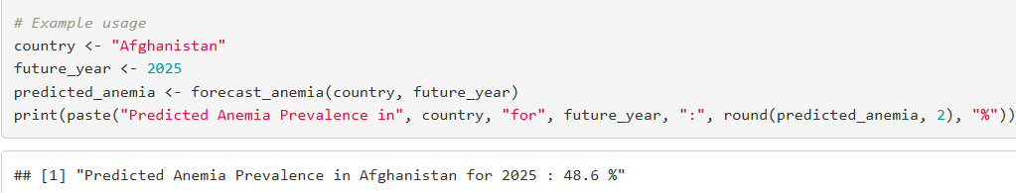
Forecasting: with different dataset:
Anaemia in non-pregnant Women (15-49):

Slide 23


References
[1] https://www.kaggle.com/datasets/ashishsahani/hospital-admissions-data
[2] Bollepalli, S.C.; Sahani, A.K.; Aslam, N.; Mohan, B.; Kulkarni, K.; Goyal, A.; Singh, B.; Singh, G.; Mittal, A.; Tandon, R.; Chhabra, S.T.; Wander, G.S.; Armoundas, A.A. An Optimized Machine Learning Model Accurately Predicts In-Hospital Outcomes at Admission to a Cardiac Unit. Diagnostics 2022, 12, 241. https://doi.org/10.3390/diagnostics12020241
[3] Dixit, A., Jha, R., Mishra, R., & Vhatkar, S. (2023). Prediction of anemia disease using machine learning algorithms. In Lecture Notes in Networks and Systems. Lecture Notes in Networks and Systems (pp. 229–238). doi:10.1007/978-981-99-0071-8_18
[4] Jaiswal, M., Srivastava, A., & Siddiqui, T. J. (2019). Machine learning algorithms for anemia disease prediction. In Lecture Notes in Electrical Engineering. Lecture Notes in Electrical Engineering (pp. 463–469). doi:10.1007/978-981-13-2685-1_44

Slide 24
THANK YOU

